Slide 1
Year 2 National Curriculum Assessments SATS

Slide 2
UK National Curriculum
Europa School is a free school.
Bilingual education.
European curriculum.
UK government funded state school.
Committed to assess standards of Year 2 children against the UK national curriculum.

Slide 3
The SATS Assessments
In May 2019 Children will take assessments in Reading and Maths.
Europa school has chosen not to administer optional Grammar, Punctuation and Spelling SAT assessment.
Four papers over four days.
In class just as a normal progress assessment. We don’t mention SATs at any point to children.

Slide 4
Assessing against UK average
New UK curriculum in 2014. More rigorous and sets high expectations.
“Working towards”, “working at” and “working at greater depth” according to the Year 2 expectations.
As of 2016, test scores reported as ‘scaled scores’. 100 is national average.
Scaled scores change every year. In previous years 100 was equivalent to: (over both papers)
maths - 37/60 reading - 25/40

Slide 5
Reading Test
Texts will cover range of poetry, fiction and non-fiction.
Paper 1
Combined reading prompt and answer booklet.
Includes useful words and practice questions.
30 minutes but not strictly timed.
Paper 2
Separate reading booklet and answer booklet.
No practice questions.
Teachers can stop test early if pupil is struggling.
40 minutes to complete, but not strictly timed.

Slide 6
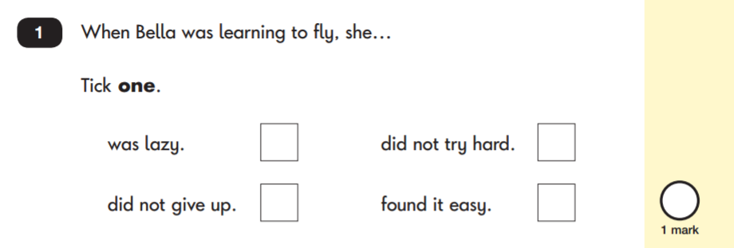
Reading Sample Questions Multiple Choice

Slide 7
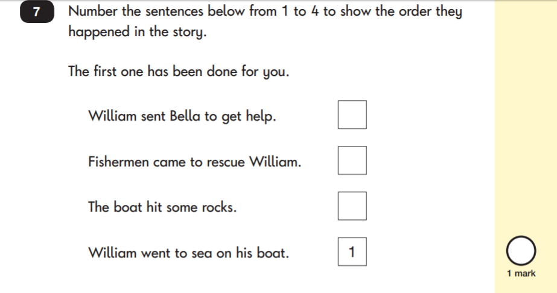
Reading Sample Questions Ranking/Order

Slide 8
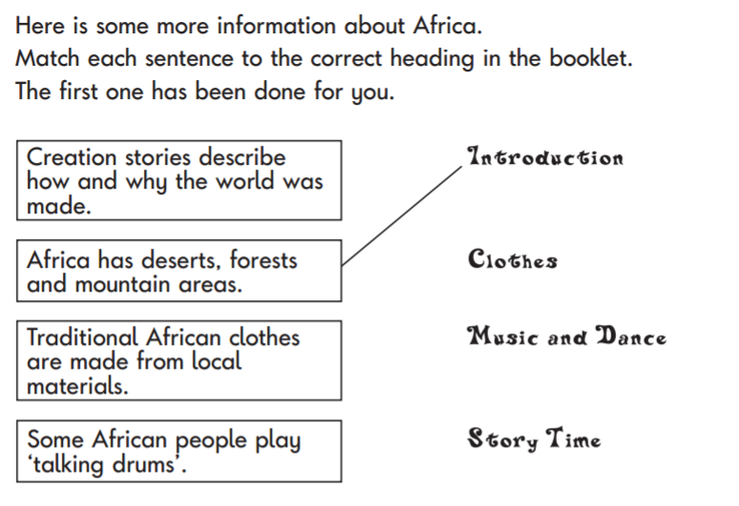
Reading Sample Questions Matching/Labels

Slide 9
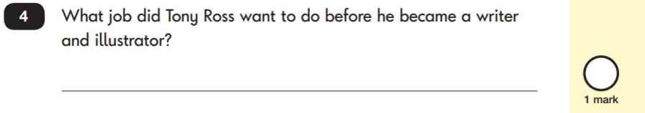
Reading Sample Questions Short answer

Slide 10
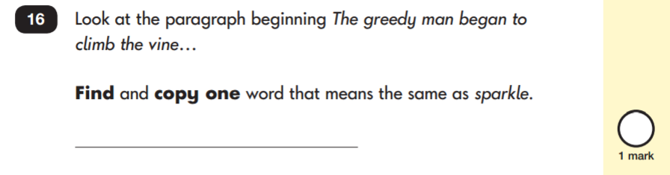
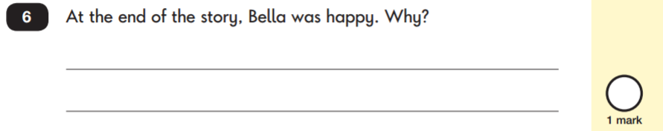
Reading Sample Questions
Open-ended question

Slide 11
Mathematics
Paper 1: Arithmetic
Covers calculation methods for all operations.
20 minutes but not strictly timed.
Paper 2: Reasoning
Questions include multiple choice, matching, true/false, completing a chart or table or drawing a shape.
Some questions will also require children to show or explain their working out.
35 minutes but not strictly timed. Includes time for 5 aural questions.

Slide 12
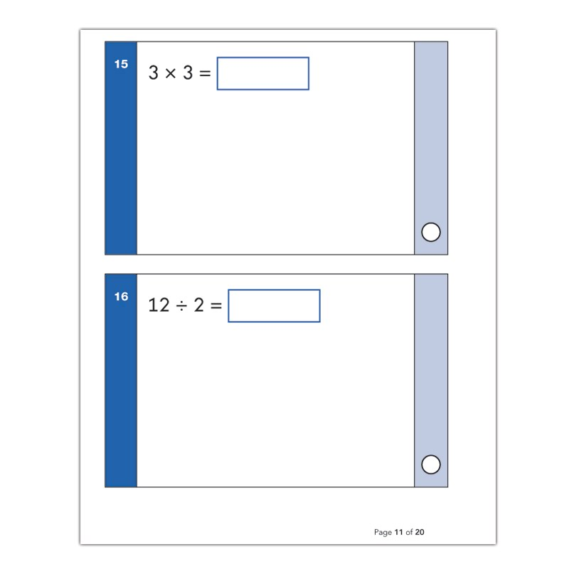
Maths Paper 1: Arithmetic

Slide 13
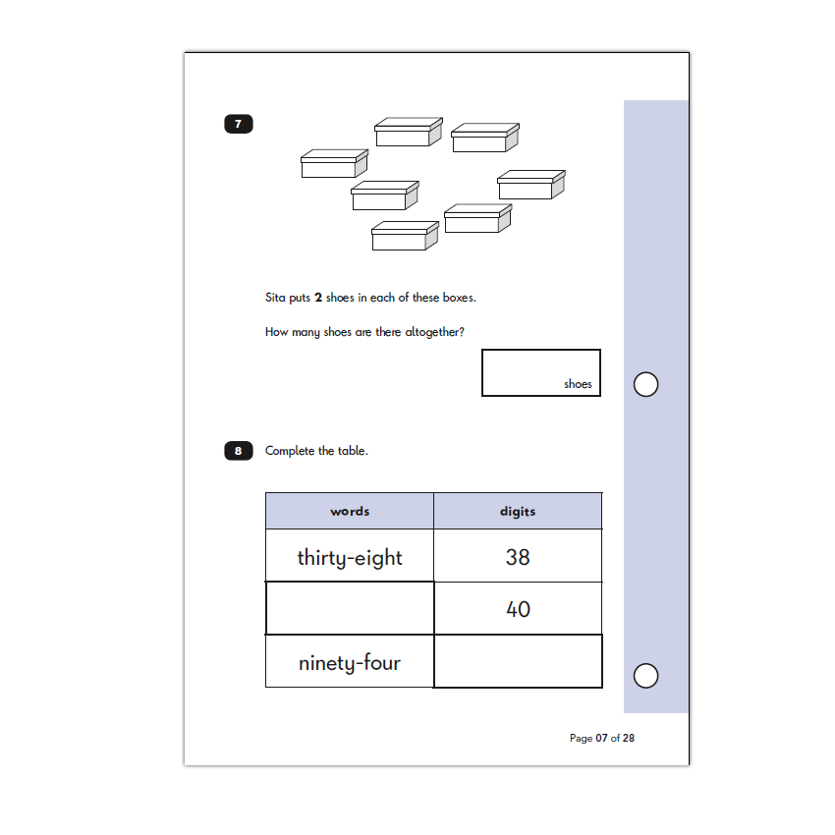
Maths Paper 2: Reasoning

Slide 14
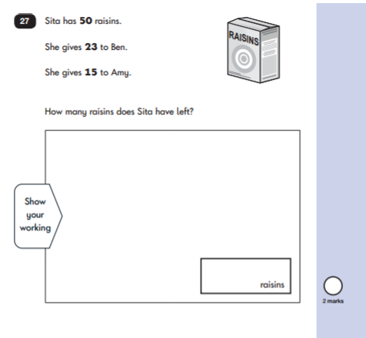
Maths Paper 2: Reasoning

Slide 15
How to help your child
Support, praise and encourage. Trying our best is always enough.
Ensure your child has best possible attendance at school.
Support your child with homework tasks.
Reading, spelling and arithmetic (e.g. times tables) always good to practise.
Talk to your child about what they have learnt at school and what book they are reading (the character, the plot, their opinion).
Make sure your child has a good sleep and healthy breakfast every morning!

Slide 16
Supporting Reading
Enjoy stories together – reading stories to your child is equally as important as listening to your child read.
Read a little at a time but often.
Talk about the story before, during and afterwards – discuss plot, characters, their feelings and actions, predict what will happen and encourage your child to have their own opinions.
Look up definitions of words together.
All reading is valuable – it doesn’t have to be just stories.

Slide 17
Supporting Writing
Practise and learn weekly spelling lists – make it fun.
Encourage opportunities for writing, letters, shopping lists, notes, stories or poems.
Write together – be a good role model for writing.
Identify good writing features when reading (e.g. vocabulary, sentence structure, punctuation).
Show your appreciation: praise and encourage, even for small successes.

Slide 18
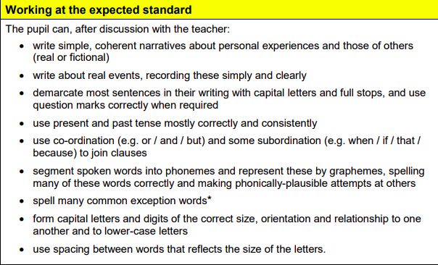
Writing

Slide 19
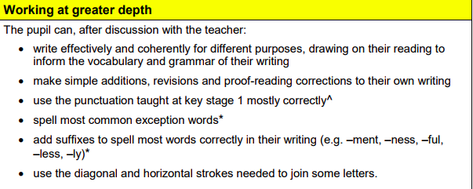
Writing

Slide 20
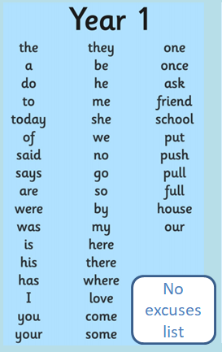
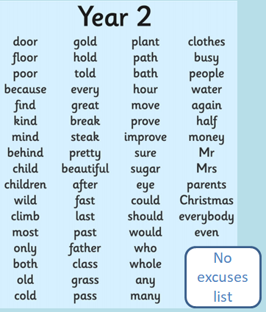
Common Exception Words

Slide 21
Supporting Maths
Play times tables games for 2,3,5,10 x tables.
Play counting in different amounts, forwards and backwards.
Encourage opportunities for telling the time – o’clock, half past, quarter past/to, then 5’s.
Encourage opportunities for counting coins and money.
Play ‘how many faces’ does this shape have for 3D shapes.
Identify, weigh or measure quantities and amounts in recipes.

Slide 22
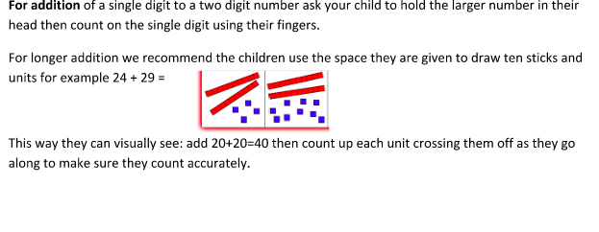
Addition

Slide 23
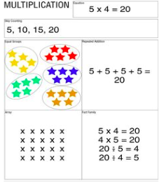
Multiplication

Slide 24
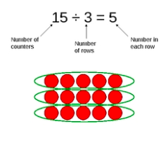
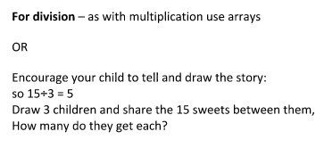
Division

Slide 25
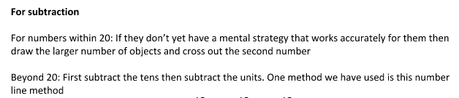

Subtraction

Slide 26
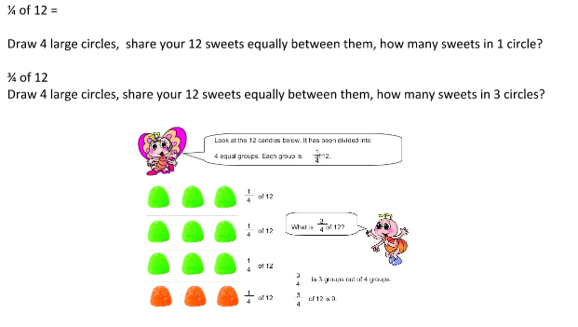
Fractions

Slide 27
Reasoning
Identify key words
Circle them
Draw the problem
Work one out together – what did we learn?
Try another one independently
Praise good thinking

Slide 28


Slide 29
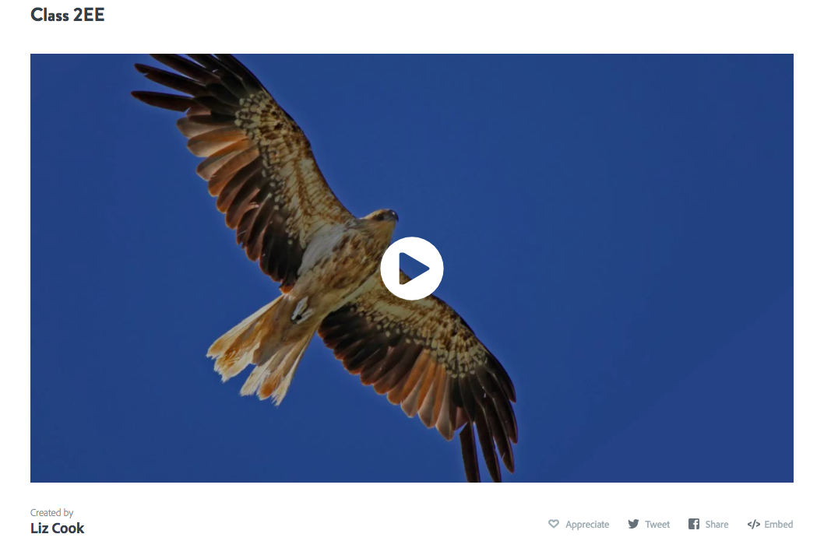
https://spark.adobe.com/video/E38soxT4ZvqSC

